Slide 1
ECE2810J Data Structures and Algorithms
Average-Case Time Complexity of BST
Learning Objectives:
Know the average-case time complexity of search, insertion, and removal operations for a binary search tree

Slide 2


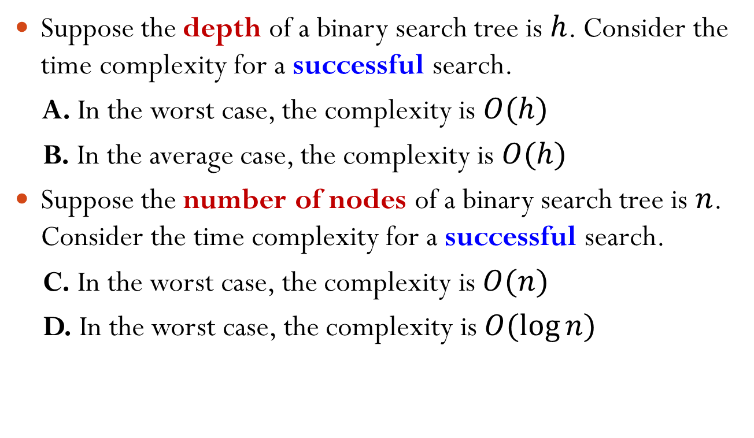
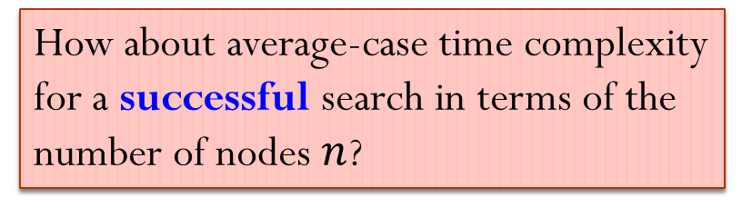
Which Statements Are Correct?
Suppose the depth of a binary search tree is $h$. Consider the time complexity for a successful search.
A. In the worst case, the complexity is $O(h)$
B. In the average case, the complexity is $O(h)$
Suppose the number of nodes of a binary search tree is $n$. Consider the time complexity for a successful search.
C. In the worst case, the complexity is $O(n)$
D. In the worst case, the complexity is $O(\log{n})$
How about average-case time complexity for a successful search in terms of the number of nodes $n$?
Notes:
Answer: A, B, & C
If the number of nodes is n, worst case happens when 1) the tree looks like a linear list and 2) the key is at the leaf

Slide 3
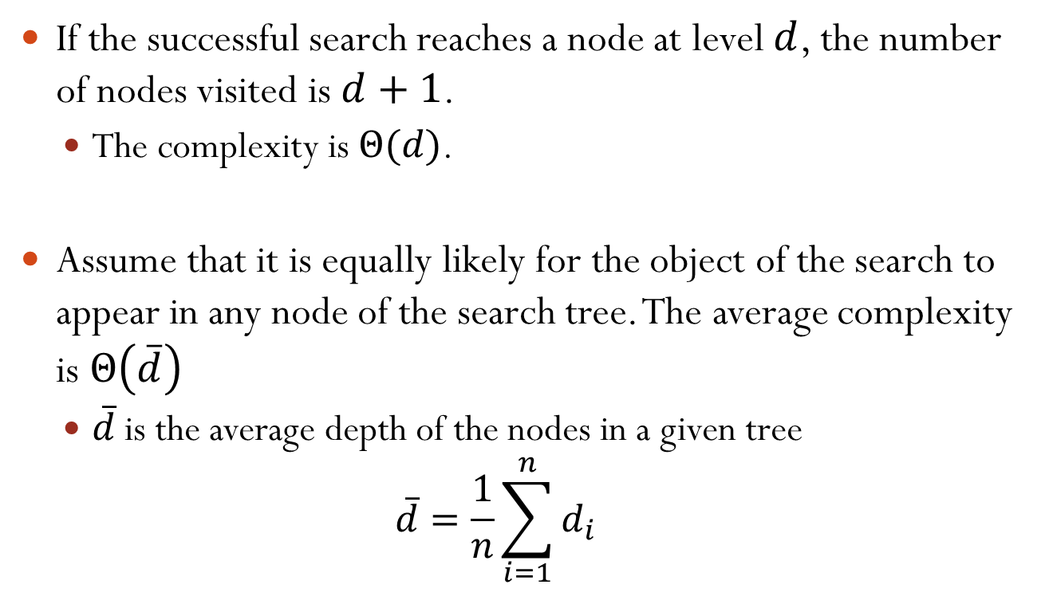
Average Case Analysis
If the successful search reaches a node at level $d$, the number of nodes visited is $d+1$.
The complexity is $Θ(d)$.
Assume that it is equally likely for the object of the search to appear in any node of the search tree. The average complexity is $Θ\left(\overline{d}\right)$
$\overline{d}$ is the average depth of the nodes in a given tree
$$\overline{d}=\frac{1}{n}\sum_{i=1}^{n}{d_{i}}$$
Notes:
At level 0, visit 1 node; at level 1, visit 2 node; etc.
What we are interested in is $\frac{1}{N}\left[\sum_{k=1}^{N}{Θ(\overline{d_{k}})}\right]$, where $N$ is the number of trees of n nodes, and k refers to the k-th tree.
$$\frac{1}{N}\left[\sum_{k=1}^{N}{Θ(\overline{d_{k}})}\right]=Θ\left(\frac{1}{N}\sum_{k=1}^{N}{\overline{d_{k}}}\right)$$

Slide 4
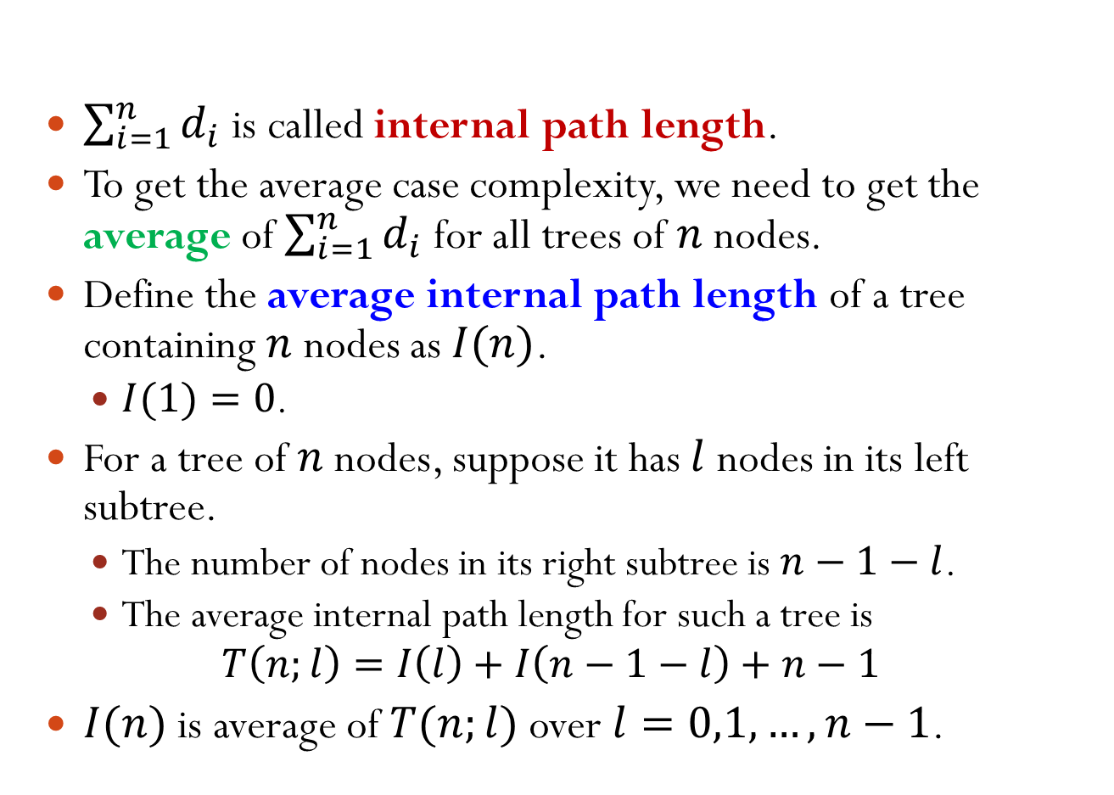
Internal Path Length
$\sum_{i=1}^{n}{d_{i}}$ is called internal path length.
To get the average case complexity, we need to get the average of $\sum_{i=1}^{n}{d_{i}}$ for all trees of $n$ nodes.
Define the average internal path length of a tree containing $n$ nodes as $I(n)$.
$I(1)=0$.
For a tree of $n$ nodes, suppose it has $l$ nodes in its left subtree.
The number of nodes in its right subtree is $n−1−l$.
The average internal path length for such a tree is
$$T\left(n;l\right)=I\left(l\right)+I\left(n−1−l\right)+n−1$$
$I(n)$ is average of $T(n;l)$ over $l=0,1,…,n−1$.
Notes:
Optional: Why are we interested in I(n)?
Answer:
$$Θ\left(\frac{1}{N}\sum_{k=1}^{N}{\overline{d_{k}}}\right)=Θ\left(\frac{1}{nN}\sum_{k=1}^{N}{\sum_{i=1}^{n}{d_{k,i}}}\right)=Θ\left(\frac{1}{n}I(n)\right)$$
T(n;l) = (I(l) + l) + (I(n-1-l) + n-1-l) = I(l) + I(n-1-l) + (n-1)

Slide 5
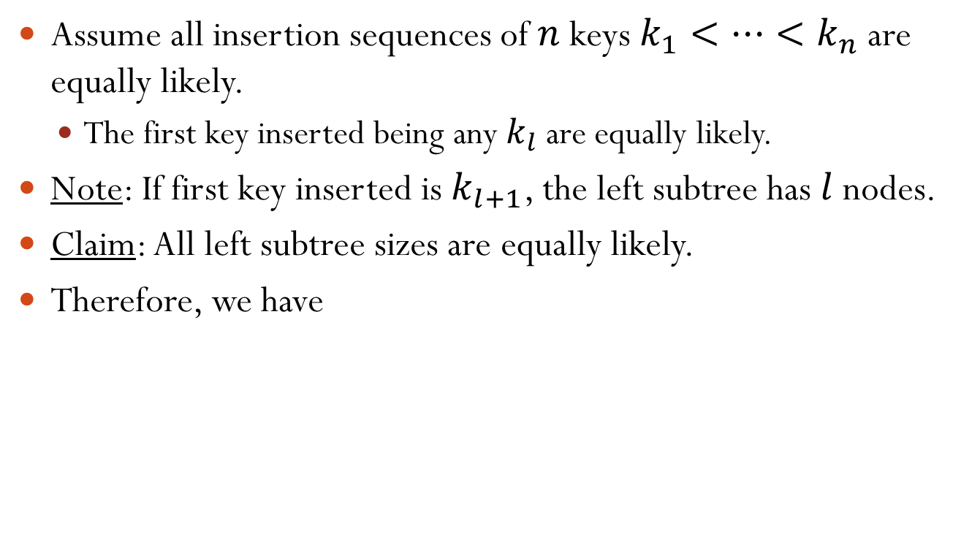
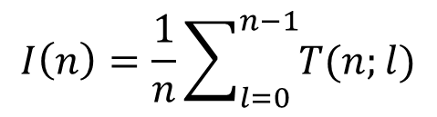
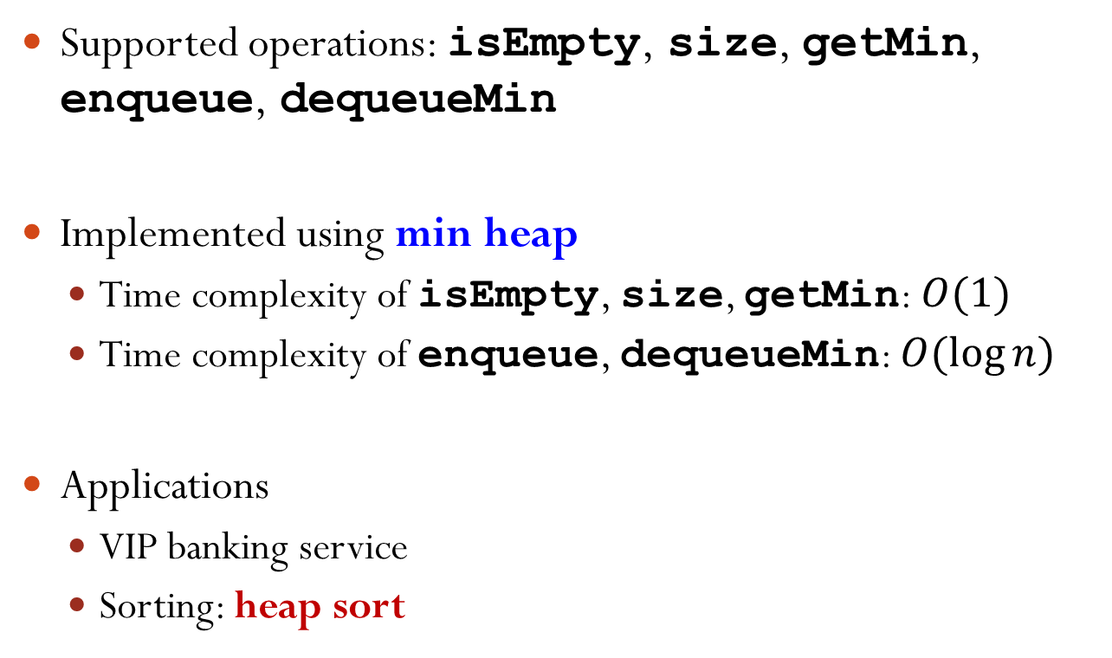
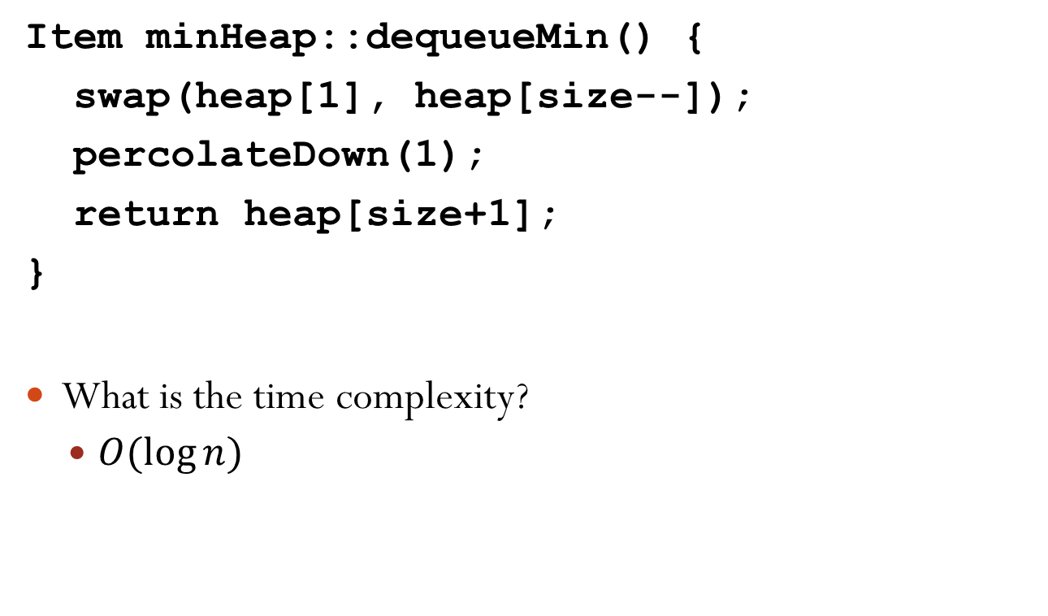
Internal Path Length
Assume all insertion sequences of $n$ keys $k_{1}<…<k_{n}$ are equally likely.
The first key inserted being any $k_{l}$ are equally likely.
Note: If first key inserted is $k_{l+1}$, the left subtree has $l$ nodes.
Claim: All left subtree sizes are equally likely.
Therefore, we have
$$I\left(n\right)=\frac{1}{n}\sum_{l=0}^{n−1}{T(n;l)}$$
$$=\frac{1}{n}\sum_{l=0}^{n−1}{[I\left(l\right)+I\left(n−1−l\right)+n−1]}$$
$$=\frac{2}{n}\sum_{l=0}^{n−1}{I\left(l\right)}+(n−1)$$

Slide 6
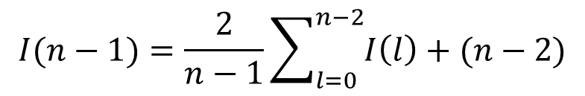
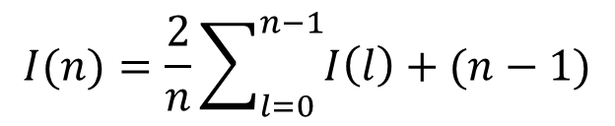

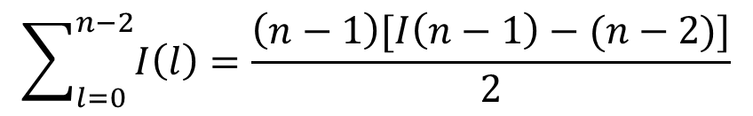
Solving the Recursion
$$I(n)=\frac{2}{n}\sum_{l=0}^{n−1}{I\left(l\right)}+(n−1)$$
replace $n$ with $n−1$
$$I(n−1)=\frac{2}{n−1}\sum_{l=0}^{n−2}{I\left(l\right)}+(n−2)$$
$$\sum_{l=0}^{n−2}{I\left(l\right)}=\frac{\left(n−1\right)[I\left(n−1\right)−(n−2)]}{2}$$

Slide 7
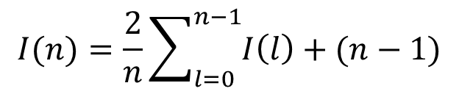
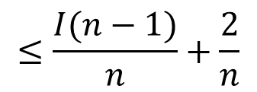
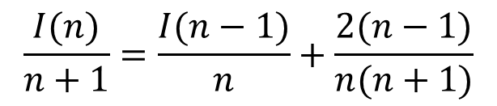
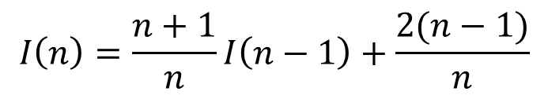
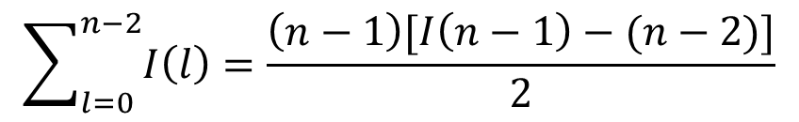
Solving the Recursion
$$I(n)=\frac{2}{n}\sum_{l=0}^{n−1}{I\left(l\right)}+(n−1)$$
$$\sum_{l=0}^{n−2}{I\left(l\right)}=\frac{\left(n−1\right)[I\left(n−1\right)−(n−2)]}{2}$$
$$I\left(n\right)=\frac{n+1}{n}I\left(n−1\right)+\frac{2(n−1)}{n}$$
$$\frac{I(n)}{n+1}=\frac{I(n−1)}{n}+\frac{2(n−1)}{n(n+1)}$$
$$≤\frac{I(n−1)}{n}+\frac{2}{n}$$
Notes:
I(n) = 2/n { I(n-1) + (n-1)/2 [ I(n-1) – (n-2) ] } + (n-1) = (n+1)/n I(n-1) + (n-1) [1 – (n-2)/n] = (n+1)/n I(n-1) + 2(n-1)/n

Slide 8
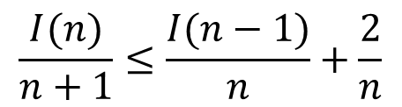

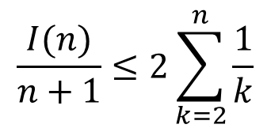
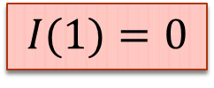
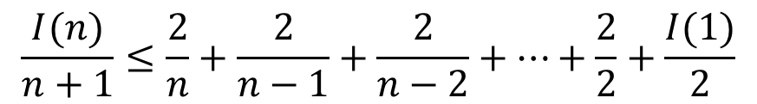
Solving the Recursion
$$\frac{I(n)}{n+1}≤\frac{I(n−1)}{n}+\frac{2}{n}$$
$$\frac{I(n)}{n+1}≤\frac{2}{n}+\frac{2}{n−1}+\frac{2}{n−2}+⋯+\frac{2}{2}+\frac{I(1)}{2}$$
$$I(1)=0$$
$$\frac{I(n)}{n+1}≤2\sum_{k=2}^{n}{\frac{1}{k}}$$
$$\sum_{k=2}^{n}{\frac{1}{k}<\ln{n}}$$
Note:
Notes:
I(n)/(n+1) <= 2/n + I(n-1)/n <= 2/n + 2/(n-1) + I(n-2)/(n-1) <= ...
I(1) = 0 from a previous slide

Slide 9
Proof of the Claim
Claim:
$$\sum_{k=2}^{n}{\frac{1}{k}}<\ln{n}$$
$$y=\frac{1}{x}$$
$$\sum_{k=2}^{n}{\frac{1}{k}}<\int_{1}^{n}{\frac{1}{x}dx}$$
y
$$=ln{n}$$
1/2
1/3
1/4
1
2
3
4
x
Notes:
Note: integrate from 1 to n. The rectangle area sum is 1/2+1/3+ ... + 1/n

Slide 10


Average Case Analysis Conclusion
What we get so far:
Thus, we have
$$I\left(n\right)=O(n\log{n})$$
Thus, the average complexity for a successful search is
$$Θ\left(\frac{1}{n}I\left(n\right)\right)=O(\log{n})$$
$$\frac{I(n)}{n+1}≤2\sum_{k=2}^{n}{\frac{1}{k}}<2\ln{n}$$
Notes:
Recall I(n) is important because the average-case runtime is proportional to the value of I(n), as $Θ\left(\frac{1}{n}I\left(n\right)\right)$

Slide 11
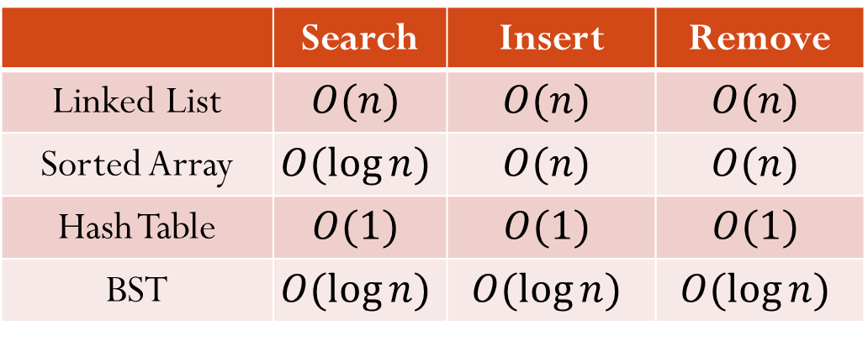

Average Case Time Complexity
It can also be shown that given $n$ nodes, the average-case time complexity for an unsuccessful search is $O(\log{n})$.
Given $n$ nodes, the average-case time complexities for search, insertion, and removal are all $O(\log{n})$.
Insertion and removal include “search”.
 | Search | Insert | Remove
Linked List | $$O(n)$$ | $$O(n)$$ | $$O(n)$$
Sorted Array | $$O(\log{n})$$ | $$O(n)$$ | $$O(n)$$
Hash Table | $$O(1)$$ | $$O(1)$$ | $$O(1)$$
BST | $$O(\log{n})$$ | $$O(\log{n})$$ | $$O(\log{n})$$
So, why we use BST, not hash table?

